Slide 1
What does rename() do?
Steve Loughran
June 2017

Slide 2
How do we safely persist & recover state?

Slide 3
Why?
Save state for when application is restarted
Publish data for other applications
Process data published by other applications
Work with more data than fits into RAM
Share data with other instances of same application
Save things people care about & want to get back

Slide 4
Define "Storage"?

Slide 5
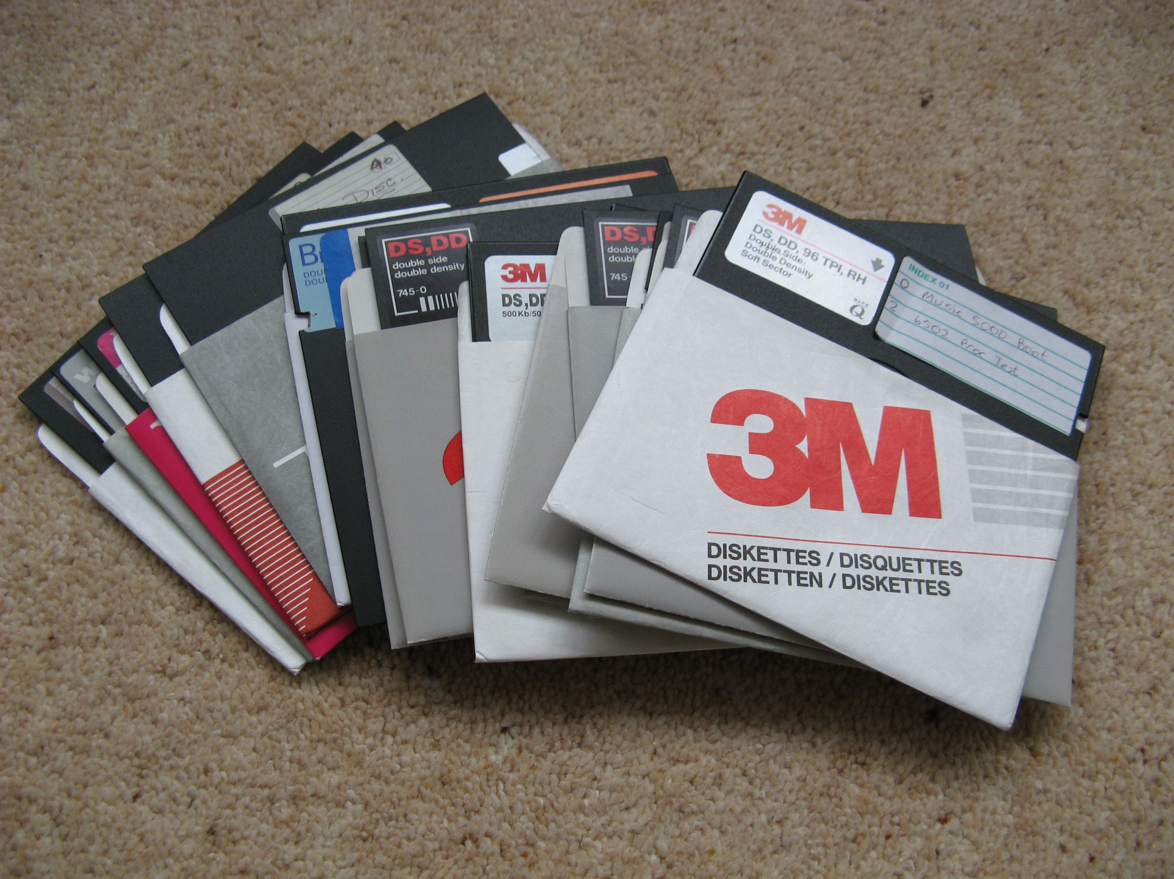
FAT8
dBASE II & Lotus 1-2-3
int 21h
Notes:
Trivia: dir rename only came with DOS 3.0

Slide 6
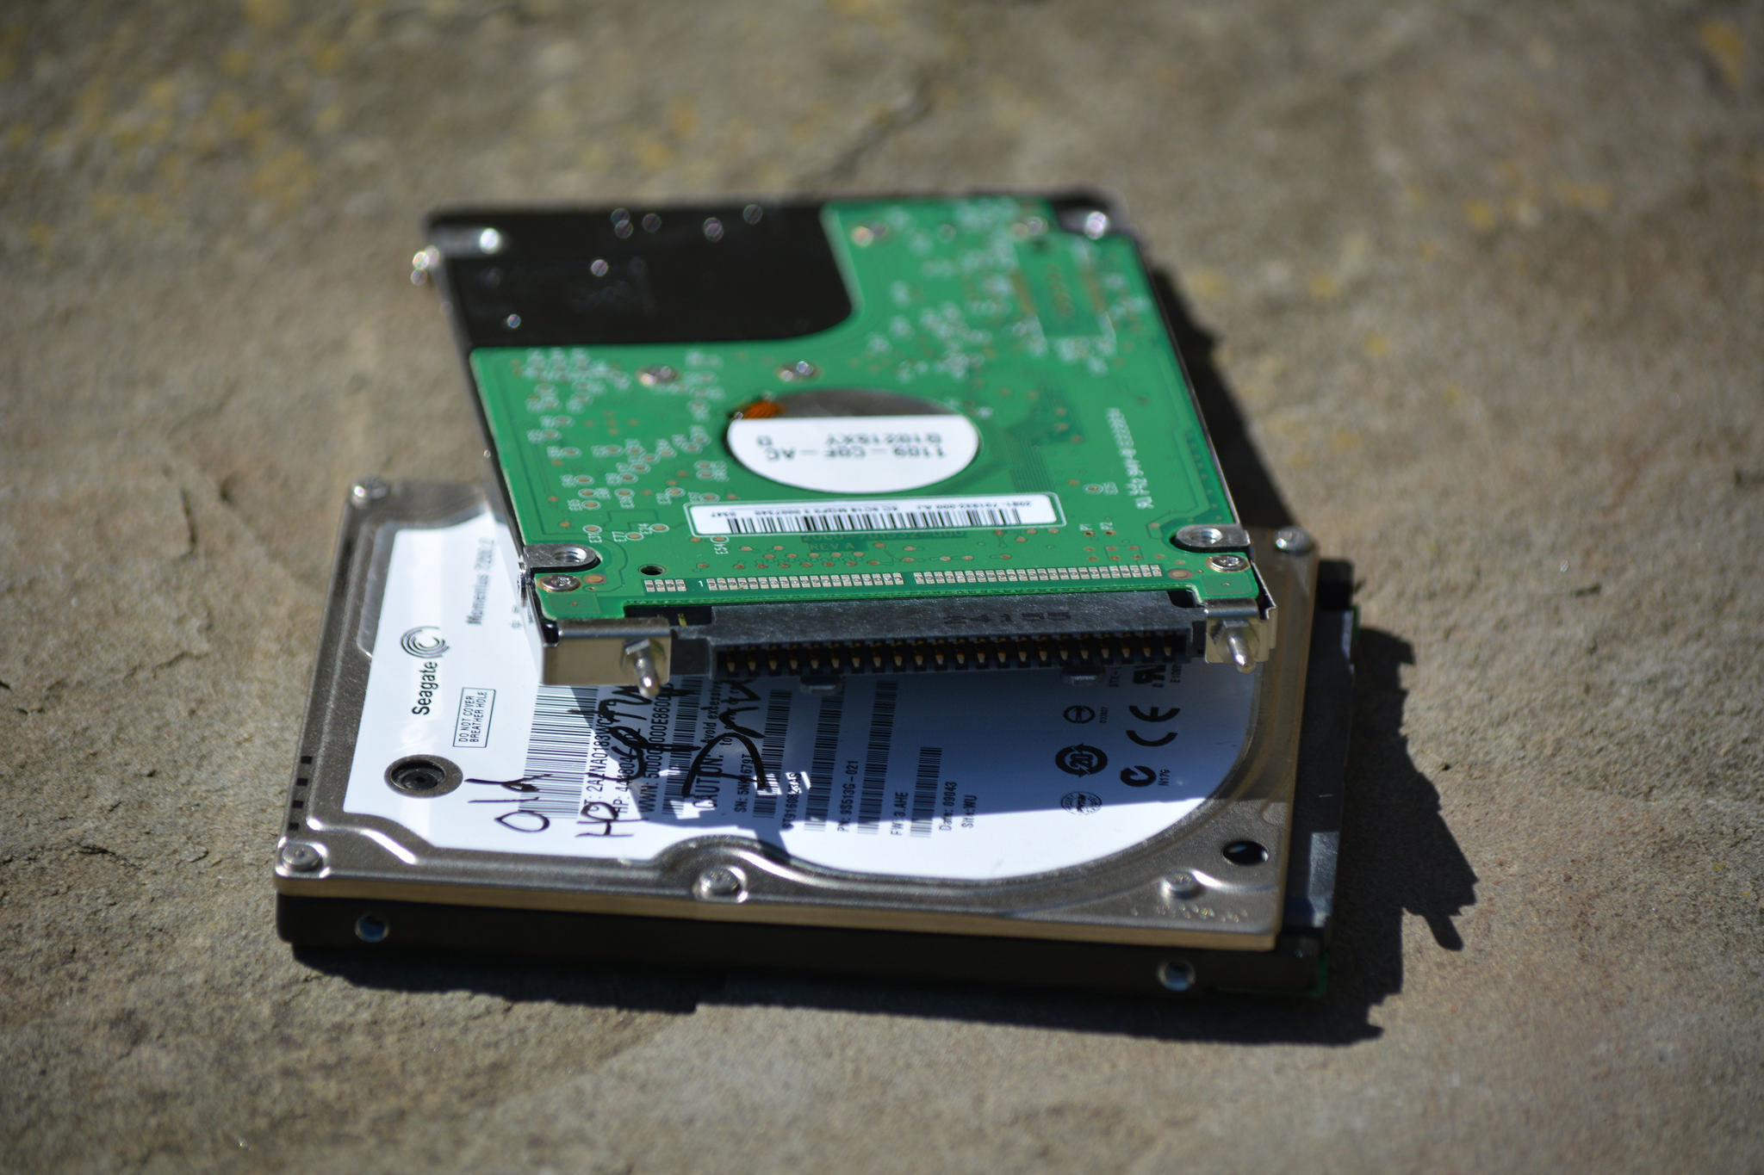
Linux: ext3, reiserfs, ext4
sqlite, mysql, leveldb
open(path, O_CREAT|O_EXCL)
rename(src, dest)
Windows NT, XP
NTFS
Access, Excel
CreateFile(path, CREATE_NEW,...)
MoveFileEx(src, dest, MOVEFILE_WRITE_THROUGH)

Slide 7

Facebook Prineville Datacentre
1+ Exabyte on HDFS + cold store
Hive, Spark, ...
FileSystem.rename()
Notes:
Facebook prineville photo store is probably at the far end of the spectrum

Slide 8
Model and APIs

Slide 9
Structured data: algebra
Notes:
Zermelo–Fraenkel set theory (with axiom of choice) and a relational algebra. Or, as it is known: SQL

Slide 10
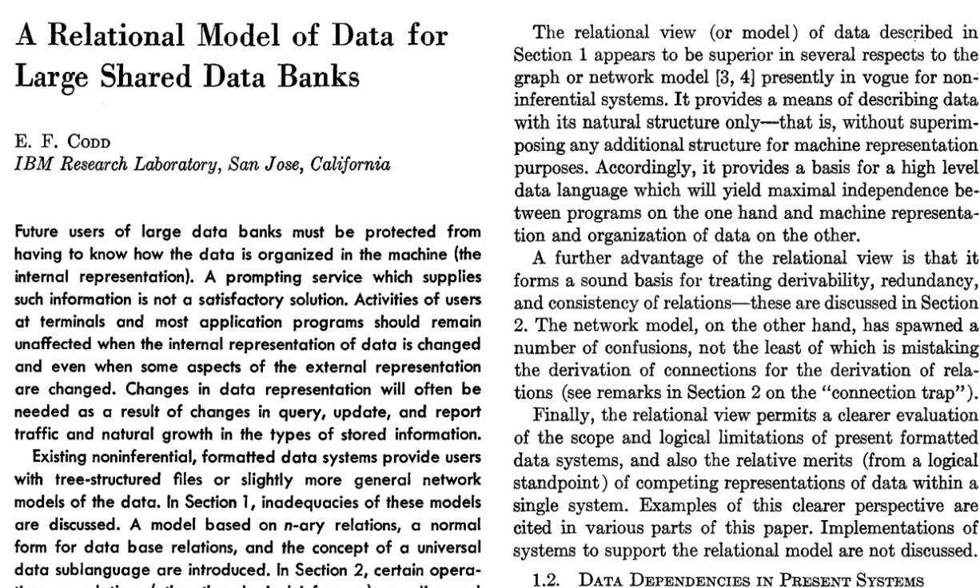
Notes:
Relational Set theory

Slide 11
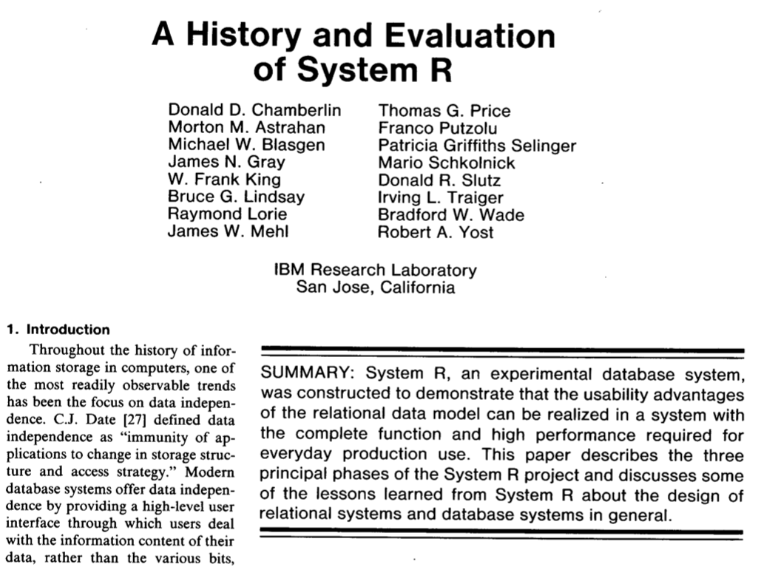

Slide 12
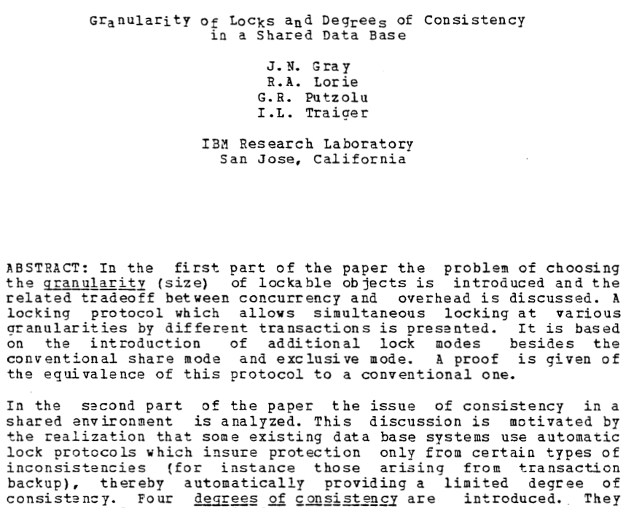

Slide 13
File-System
Directories and files
Posix with stream metaphor

Slide 14









Posix: hierarchical (distributed?) filesystems
org.apache.hadoop.fs.FileSystem
hdfs
wasb
s3a
swift
adl
gcs
Notes:
Everything usies the Hadoop APIs to talk to both HDFS, Hadoop Compatible Filesystems and object stores; the Hadoop FS API. There's actually two: the one with a clean split between client side and "driver side", and the older one which is a direct connect. Most use the latter and actually, in terms of opportunities for object store integration tweaking, this is actually the one where can innovate with the most easily. That is: there's nothing in the way.
Under the FS API go filesystems and object stores.
HDFS is "real" filesystem; WASB/Azure close enough. What is "real?". Best test: can support HBase.

Slide 15
val work = new Path("s3a://stevel-frankfurt/work")
val fs = work.getFileSystem(new Configuration())
val task00 = new Path(work, "task00")
fs.mkdirs(task00)
val out = fs.create(new Path(task00, "part-00"), false)
out.writeChars("hello")
out.close();
fs.listStatus(task00).foreach(stat =>
fs.rename(stat.getPath, work)
)
val statuses = fs.listStatus(work).filter(_.isFile)
require("part-00" == statuses(0).getPath.getName)

Slide 16
rename() gives us O(1) atomic task commits
HDFS Namenode
Datanode-01
Datanode-02
/
00
01
work
00
_temp
part-01
task-00
task-01
01
00
01
part-00
part-01
rename("/work/_temp/task00/*", "/work")
Datanode-03
Datanode-04
Notes:
This is how we commit work in Hadoop FileOutputFormat, and so, transitively, how Spark does it too (Hive does some other things, which I'm ignoring, but are more manifest file driven)

Slide 17
Amazon S3 doesn't have a rename()
/
S3 Shards
work
00
01
_temp
01
00
part-01
task-00
task-01
part-00
part-01
01
00
01
01
LIST /work/_temp/task-01/*
01
COPY /work/_temp/task-01/part-01 /work/part-01
DELETE /work/_temp/task-01/part-01

Slide 18
Fix: fundamentally rethink how we commit
/
S3 Shards
work
00
01
00
part-01
POST /work/part-01?uploads => UploadID
POST /work/part01?uploadId=UploadID&partNumber=01
00
POST /work/part01?uploadId=UploadID&partNumber=02
01
01
POST /work/part01?uploadId=UploadID&partNumber=03

Slide 19
job manager selectively completes tasks' multipart uploads
/
S3 Shards
work
00
01
01
00
part-00
part-01
part-01
(somehow list pending uploads of task 01)
POST /work/part-01?uploadId=UploadID <CompleteMultipartUpload> <Part> <PartNumber>01</PartNumber><ETag>44a3</ETag> <PartNumber>02</PartNumber><ETag>29cb</ETag> <PartNumber>03</PartNumber><ETag>1aac</ETag> </Part> </CompleteMultipartUpload>
00
01
01
01
01

Slide 20
S3A O(1) zero-rename commit demo!

Slide 21
What else to rethink?
Hierarchical directories to tree-walk ==> list & work with all files under a prefix;
seek() read() sequences ==> HTTP-2 friendly scatter/gather IO read((buffer1, 10 KB, 200 KB), (buffer2, 16 MB, 4 MB))
How to work with Eventually Consistent data?
or: is everything just a K-V store with some search mechanisms?

Slide 22
Model #3: Storage as Memory

Slide 23
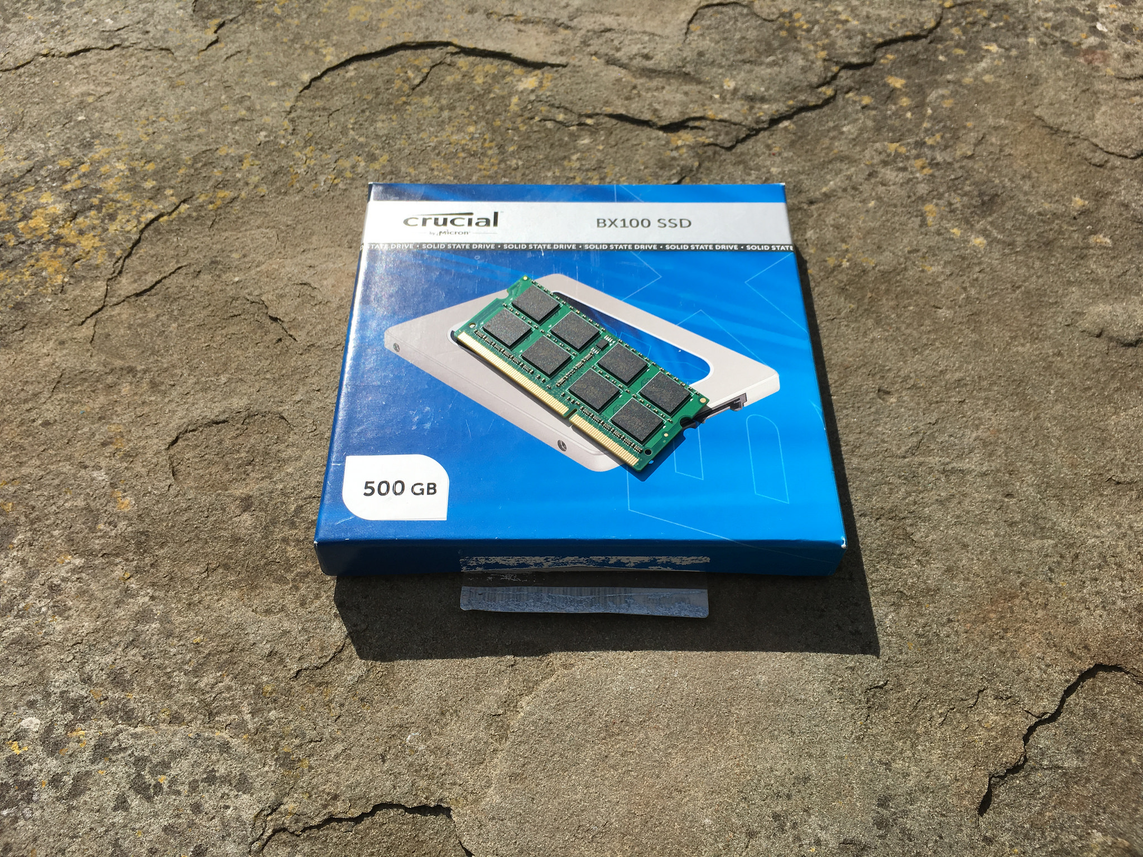
SSD via SATA
SSD via NVMe/M.2
Future NVM technologies

Slide 24
typedef struct record_struct {
int field1, field2;
long next;
} record;
int fd = open("/shared/dbase", O_CREAT | O_EXCL);
record* data = (record*) mmap(NULL, 8192,
PROT_READ | PROT_WRITE, MAP_SHARED, fd, 0);
(*data).field1 += 5;
data->field2 = data->field1;
msync(record, sizeof(record), MS_SYNC | MS_INVALIDATE);
Notes:
This is my rough guess at a C-level operation against mmaped data today. Ignoringthe open/sync stuff, then the writes in the middle are the operations we need to worry about, as they update the datastructures in-situ. Nonatomically.

Slide 25
Non Volatile Memory
SSD-backed RAM
near-RAM-speed SSD
Future memory stores
RDMA access to NVM on other servers
What would a datacentre of NVM & RDMA access do?

Slide 26
typedef struct record_struct {
int field1, field2;
record_struct* next;
} record;
int fd = open("/shared/dbase");
record* data = (record*) pmem_map(fd);
// lock ?
(*data).field1 += 5;
data->field2 = data->field1;
// commit ?
Notes:
This is my rough guess at a C-level operation against mmaped data today. Ignoringthe open/sync stuff, then the writes in the middle are the operations we need to worry about, as they update the datastructures in-situ. Nonatomically.

Slide 27
NVM moves the commit problem into memory I/O
How to split internal state into persistent and transient?
When is data saved to NVM ($L1-$L3 cache flushed, sync in memory buffers, ...)
How to co-ordinate shared R/W access over RDMA?
How do we write apps for a world where rebooting doesn't reset our state?
Catch up: read "The Morning Paper" summaries of research
Notes:
Work like RAMCloud has led the way here, go look at the papers. But that was at RAM, not NVM, where we have the persistence problem
Some form of LSF model tends to be used, which ties in well with raw SSD (don't know about other techs, do know that non-raw SSD doesn't really suit LFS)
If you look at code, we generally mix persisted (and read back) data with transient; load/save isn't so much seriaiizing out data structures as marshalling the persistent parts to a form we think they will be robust over time, unmarshalling them later (exceptions: Java Serialization, which is notoriously brittle and insecure)
What apps work best here? Could you extend Spark to make RDDs persistent & shared, so you can persist them simply by copying to part of cluster memory?, e.g a "NVMOutputFormat"

Slide 28
Summary: Storage is moving in different directions
Blobstore APIs address some scale issues, but don't match app expectations for file/dir behaviour; inefficient read/write model
Non volatile memory is the other radical change
Posix metaphor/API isn't suited to either —what next?
SQL makes all this someone else's problem (leaving only O/R mapping, transaction isolation...)

Slide 29
Questions?

